Slide 1
How it Works: ICBC Part 7 Benefits
Murphy Battista LLP
Vancouver B.C.
604-683-9621
1-888-683-9621

Slide 2
John Doe is in An Accident

Slide 3
What Claims Does He Have
Is the accident someone else’s fault?
Negligence and Part 7
Is the accident solely his own fault?
Part 7 only

Slide 4
What Must John Doe Do?
Report the accident to ICBC promptly, himself or through a lawyer
Within 30 days, provide written notice of details of accident and injuries
Within 90 days, complete an Accident Benefits Application Form (a “CL22”)

Slide 6
John’s Neck Hurts – What To Do?

Slide 7
Go To Family Doctor or WIC
Doctor recommends physiotherapy (s. 88(1);
Doctor writes a prescription;
Doctor recommends massage therapy;
Doctor recommends a pain management program (s. 88(2);

Slide 8
What Will ICBC Pay?
Does John have another benefit provider?
ICBC pays the MSP rate
Injured party must pay the “user fee”
User fee can be recovered in negligence claim, if any

Slide 9
How much coverage for rehab?
Up to $150,000
ICBC’s policies are not law

Slide 10
Homemaker Benefits

Slide 11
Homemaker Benefits
If the injuries prevent John from “regularly performing most [his] household tasks”, homemaker benefits can be accessed
Max of $145/week
Must be outside the family
May include cooking, cleaning, laundry, general household tasks

Slide 12
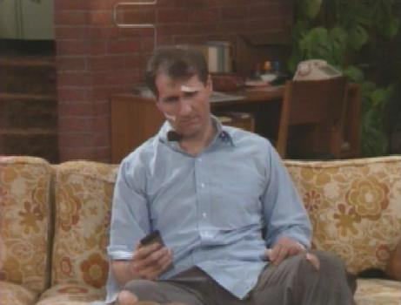
What if John Can’t Work?

Slide 13
What if John Can’t Work?
Total Temporary Disability Benefits (“TTD”)
John is eligible if employed at the time of the accident or worked 50% of the year before
Maximum benefit of $300/week
Calculated at 75% of the person’s average earnings
Anybody earning over $20,000/year will get the maximum
Can be used to top up his other coverage to 75%

Slide 14
TTD Benefits
They do not form part of the $150,000 maximum
They are payable after one week waiting period
They are payable for 2 years if you cannot do your job
Thereafter, they are payable to 65 if you cannot do any reasonable alternative
Ensure also applying for Employment Insurance

Slide 15
Death Benefits
In the case of death, limited benefits for family members
$2,500 for funeral expenses
Amount of benefits to surviving family members depends on circumstances

Slide 16
John’s Injuries are Catastrophic and Permanent
John needs to maximize the effectiveness of his benefits
Home renovations
A modified vehicle
Prosthetics

Slide 17
ICBC Gives John the Run-Around
Arbitration if the issue is whether an expense is reasonable
Sue ICBC if they refuse to pay
Must sue within 2 years of the accident or last Part 7 payment (including for children)
Must be careful not to miss deadlines

Slide 18
Can ICBC Send John to Their Own Doctor?
Yes – primary purpose is to determine entitlement to Part 7 benefits
Can the ICBC adjuster insist that I take certain treatment?
Yes and no – if you refuse treatment that your doctor thinks would help you, then ICBC is allowed to cut off any Part 7 benefits

Slide 19
Details
Not meant to be comprehensive
“The large print giveth and the small print taketh away”
Consult a lawyer to ensure you are covered and treated fairly

Slide 20
Further Questions?
Call a lawyer at Murphy Battista
604-683-9621
1-888-683-9621
Kevin Gourlay: gourlay@murphybattista.com
Direct: 604-633-3812

